Slide 1
C Programming
Recursion

Slide 2
Recursion
A function that calls itself is known as a recursive function. And, this technique is known as recursion.
The process continues until a condition is met.

Slide 3
How recursion works?
void recurse()
{
... .. ...
recurse();
... .. ...
}
int main()
{
... .. ...
recurse();
... .. ...
}

Slide 4
Recursion
To prevent infinite recursion, if...else statement (or similar approach) can be used where one branch makes the recursive call and other doesn't.

Slide 5
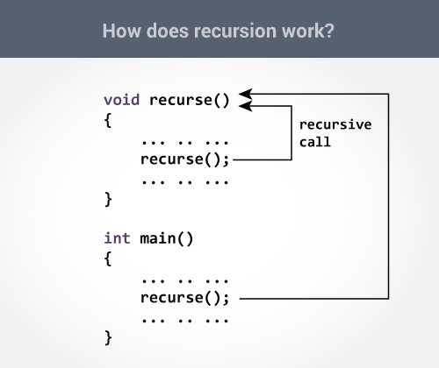
How Recursion Works?

Slide 6
Recursion: Factorial Example
#include <stdio.h>
long int Fact(int n);
int main()
{
int n;
printf("Enter a positive integer: ");
scanf("%d", &n);
printf("Factorial of %d = %d", n, Fact(n));
return 0;
}
long int Fact(int n)
{
if (n >= 1)
return n*Fact(n-1);
else
return 1;
}

Slide 7
Output
Enter a positive integer:3
Factorial of 3 = 6

Slide 8
main()
{
printf("Factorial of %d = %ld", n, Fact(n));
/*suppose n is 3*/
}
long int Fact((3)
{
if (n >= 1)
return 3*Fact(2);
/* 3 * 2 is returned */
else
return 1;
}
long int Fact(2)
{
if (n >= 1)
return 2*Fact(1);
/*return 2 * 1 */
else
return 1;
}
long int Fact(1)
{
if (n >= 1)
return 1*Fact(0);
/*Returns 1 *1 */
else
return 1;
}
long int Fact(int 0)
{
if (n >= 1)
return 1*Fact(0);
else
return 1;
/*returns 1 */
}

Slide 9
Practice Example
WAP to Find sum of numbers from 1 to n using recursion

Slide 10
Solution
#include <stdio.h>
int sum(int n);
int main()
{
int number, result;
printf("Enter a positive integer: ");
scanf("%d", &number);
result = sum(number);
printf("sum = %d", result);
return 0;
}
int sum(int num)
{
if (num!=0)
return num + sum(num-1); // sum() function calls itself
else
return num;
}

Slide 11
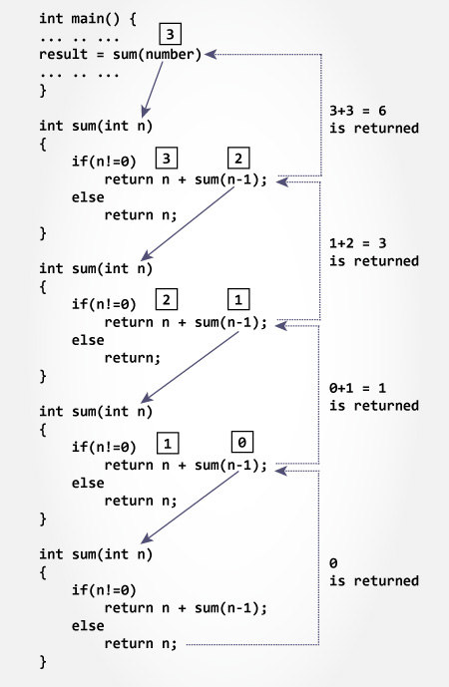

Slide 12
Advantages and Disadvantages
Recursion makes program elegant and more readable. However, if performance is vital then, use loops instead as recursion is usually much slower.
Recursion Vs Iteration? Need performance, use loops, however, code might look ugly and hard to read sometimes. Need more elegant and readable code, use recursion, however, you are sacrificing some performance.

Slide 13
Some Problems on Recursion
Write a program in C to Print Fibonacci Series using recursion
0 1 1 2 3 5 8 13
Write a program in C to find the sum of digits of a number using recursion

